Slide 1
CAP776 PROGRAMMING IN PYTHON

Slide 2
Machine learning :
introduction,
types of machine learning,
linear regression,
k-nearest neighbours,
decision trees,
random forests,
k-means clustering

Slide 3

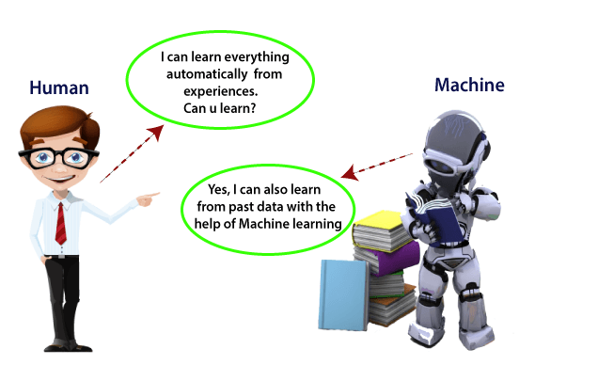
Machine learning

Slide 4
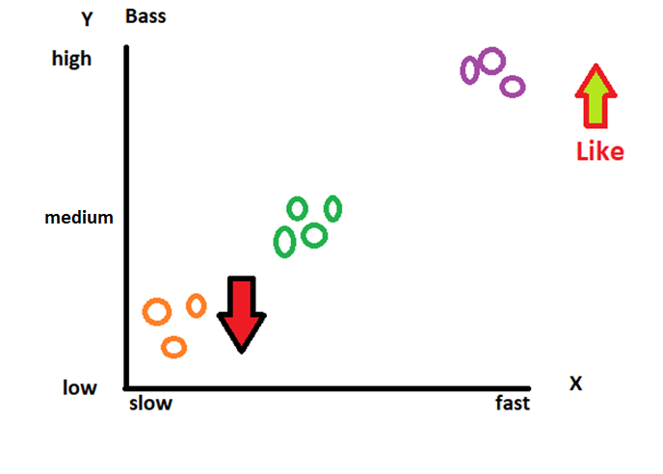
?
Suppose I like song based on songs type and music intensity.
Now one new song introduce which is having medium bass then I will like the song?

Slide 5
Machine learning
Machine learning is a growing technology which enables computers to learn automatically from past data. Machine learning uses various algorithms for building mathematical models and making predictions using historical data or information.
Currently, it is being used for various tasks such as image recognition, speech recognition, email filtering etc.

Slide 6
How does Machine Learning work
A Machine Learning system learns from historical data, builds the prediction models, and whenever it receives new data, predicts the output for it.

Slide 7
types of machine learning
Machine learning can be classified into three types:
Supervised learning
Unsupervised learning
Reinforcement learning

Slide 8
Supervised learning is a type of machine learning method in which we provide sample labeled data to the machine learning system in order to train it, and on that basis, it predicts the output.

Slide 9
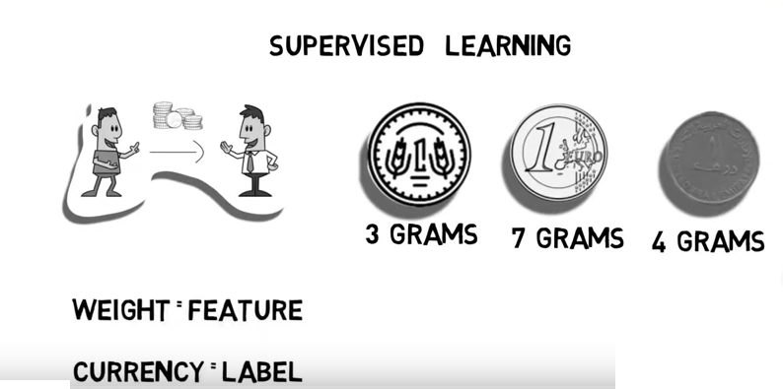

Slide 10
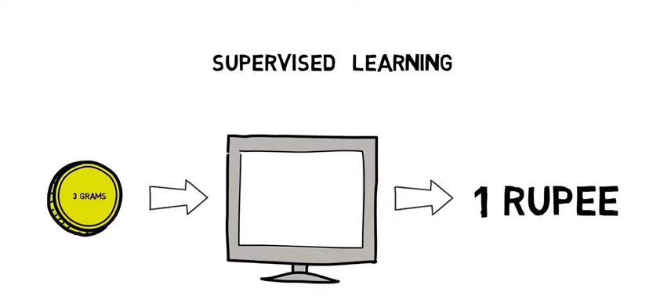

Slide 11
Unsupervised learning is a learning method in which a machine learns without any supervision. The training is provided to the machine with the set of data that has not been labeled, classified, or categorized, and the algorithm needs to act on that data without any supervision.

Slide 12
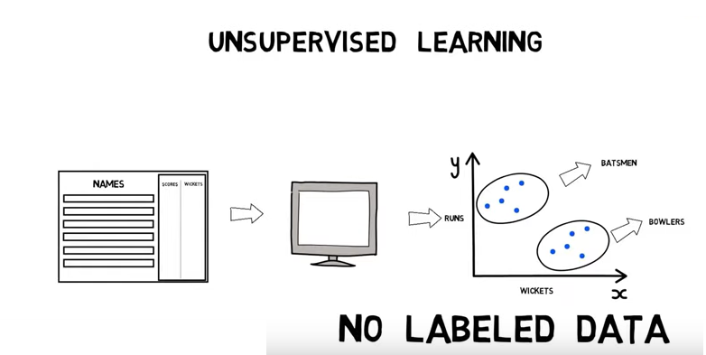

Slide 13
Reinforcement learning is a feedback-based learning method, in which a learning agent gets a reward for each right action. The agent learns automatically with these feedbacks and improves its performance.

Slide 14
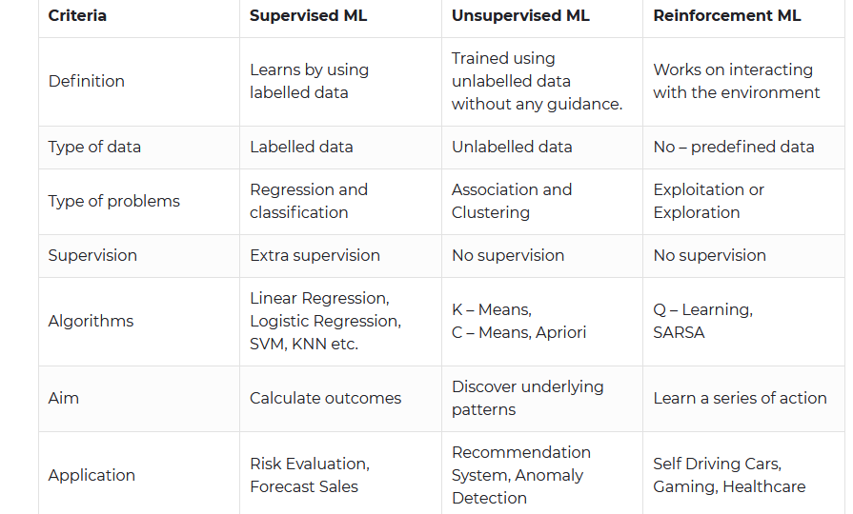

Slide 15
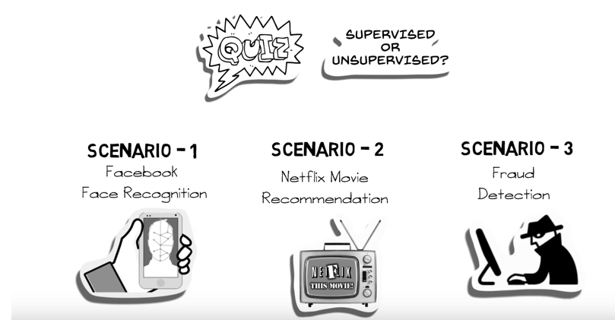

Slide 16
linear regression
The term regression is used when we try to find the relationship between variables.
In Machine Learning, and in statistical modeling, that relationship is used to predict the outcome of future events.
Linear regression algorithm shows a linear relationship between a dependent (y) and one or more independent (x) variables, hence called as linear regression.
Linear regression can be further divided into two types of the algorithm: Simple Linear Regression and Multiple Linear regression

Slide 17
Simple Linear Regression
Suppose we want to predict weight of a person from his height. So here, one dependent and one independent variable is used.
So, here weight is dependent variable and height is independent variable.
If a single independent variable is used to predict the value of a dependent variable, then such a Linear Regression algorithm is called Simple Linear Regression.

Slide 18
Multiple Linear regression
If more than one independent variable is used to predict the value of dependent variable, then such a Linear Regression algorithm is called Multiple Linear Regression.
Suppose we want predict house rent then there will multiple independent variables based on that we can predict house rent.

Slide 19
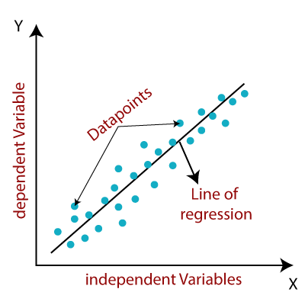
Since linear regression shows the linear relationship, which means it finds
how the value of the dependent variable is changing according to the value of the
independent variable.

Slide 20
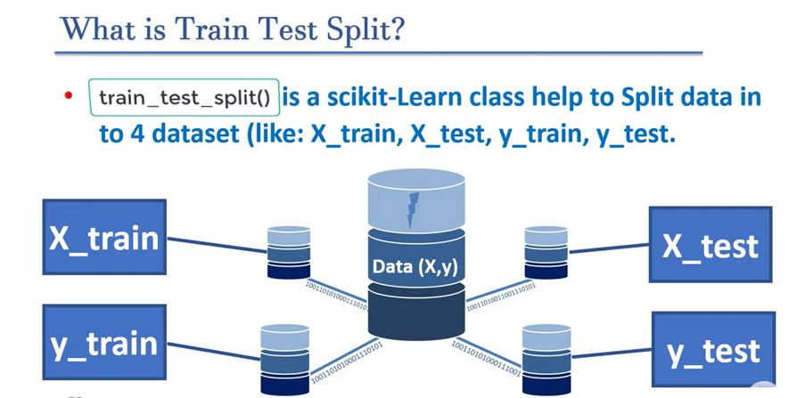
A train test split is when you split your data into a training set and a testing set.
1.

Slide 21
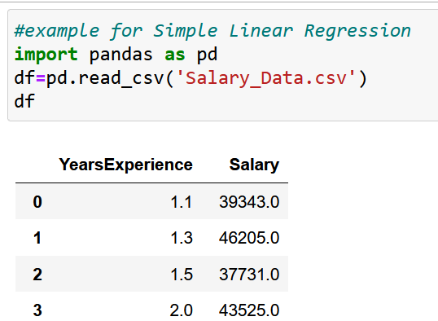
example for Simple Linear Regression
Import your dataset

Slide 22
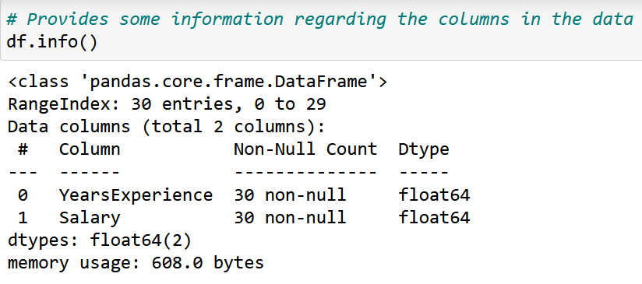

Slide 23
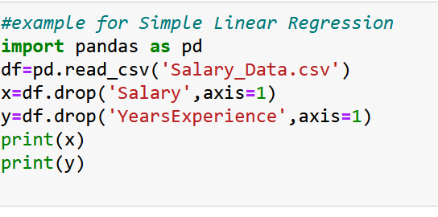
Define your dataset with dependent and independent variables

Slide 24
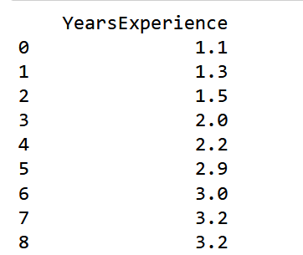
independent variable:

Slide 25
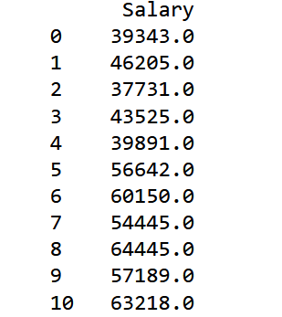
dependent variable:

Slide 26
Splitting the dataset into training and test set.
For that use scikit-learn
Install scikit-learn
Import now:

Slide 27
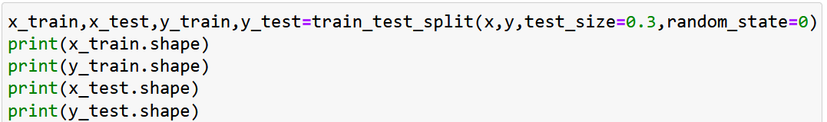
The train_test_split() method is used to split our data into train and test sets. First, we need to divide our data into features (X) and labels (y).
Use train_test_split()
test_size: define size of data set 0.3 means 30%
random_state=0 means value will be not shuffled

Slide 28
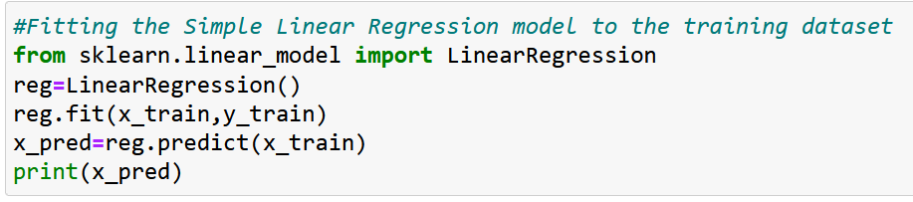
Fitting the Simple Linear Regression model to the training dataset

Slide 29
Example of prediction
import pandas as pd
from sklearn.linear_model import LinearRegression
from sklearn.model_selection import train_test_split
df = pd.read_csv('C:\\Users\\SUMIT\\OneDrive\\Desktop\\housedata.csv')
x = df.iloc[:, 0:3]
y = df.iloc[:, :-1]
X_train, X_test, y_train, y_test = train_test_split(
x, y, test_size=0.2, random_state=0)

Slide 30
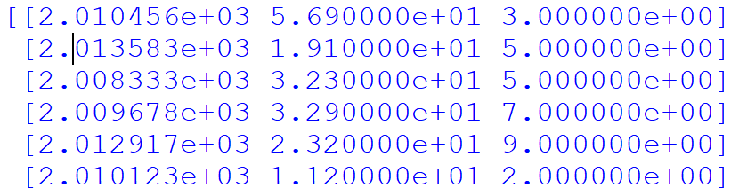
Program continues…
reg=LinearRegression().fit(x_train,y_train)
ypredict=reg.predict(x_train)
print(ypredict)
Output:-

Slide 31
Example of LinearRegression
from sklearn.linear_model import LinearRegression
import random
#create to empty lists
feature_set=[]
target_set=[]
#number of rows for dataset
number_of_rows=200
#limit the values in dataset
random_number_limit=2000

Slide 32
#create feature data set
for i in range(0,number_of_rows):
x=random.randint(0,random_number_limit)
y=random.randint(0,random_number_limit)
z=random.randint(0,random_number_limit)
#linear function for dataset
function=(10*x)+(2*y)+(3*z)
#append the data to the lists
feature_set.append([x,y,z])
target_set.append(function)

Slide 33
#create linear regression model
model=LinearRegression().fit(feature_set,target_set)
#create the test data set
test_set=[[8,10,0]]
predection=model.predict(test_set)
print("predection"+str(predection))

Slide 34
Now visualize your prediction for that we need to plot the regression line, we will use the plot() function. In this function, we will pass the years of experience for training set and predicted salary for training set x_pred

Slide 35
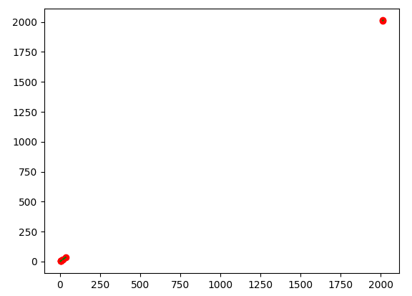
If we have to display the data using maps
plt.scatter(x_train,y_train,color='red')
plt.plot(x_train,ypredict,'s-g')
plt.show()

Slide 36
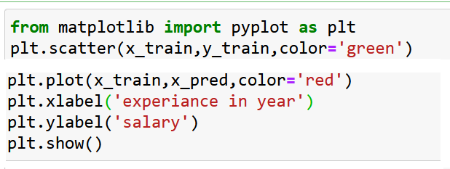
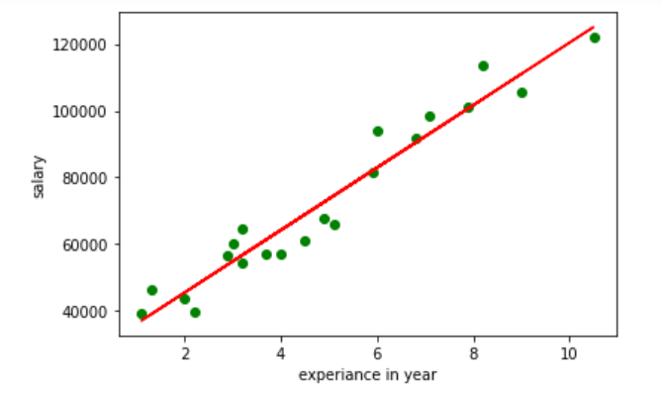

Slide 38
In the above plot, we can see the real values observations in green dots and predicted values are covered by the red regression line. The regression line shows a correlation between the dependent and independent variable.
The good fit of the line can be observed by calculating the difference between actual values and predicted values. But as we can see in the above plot, most of the observations are close to the regression line, hence our model is good for the training set.

Slide 39
k-nearest neighbours
k-nearest neighbor algorithm is supervised ML algorithm that can perform for both classification and regression tasks using (k) numbers of neighbors.

Slide 40
Both Regression and Classification algorithms are known as Supervised Learning algorithms and are used to predict in Machine learning and work with labeled datasets.
The main difference between Regression and Classification algorithms that Regression algorithms are used to predict the continuous values such as price, salary, age, etc. and Classification algorithms are used to predict/Classify the discrete values such as Male or Female, True or False, Spam or Not Spam, etc.

Slide 41
This algorithm is used to solve the classification model problems. K-nearest neighbor or K-NN algorithm basically creates an imaginary boundary to classify the data. When new data points come in, the algorithm will try to predict that to the nearest of the boundary line.
Therefore, larger k value means smother curves of separation resulting in less complex models. Whereas, smaller k value tends to overfit the data and resulting in complex models.

Slide 42
Note: It’s very important to have the right k-value when analyzing the dataset to avoid overfitting and underfitting of the dataset.
Using the k-nearest neighbor algorithm we fit the historical data (or train the model) and predict the future.

Slide 43
K-nearest example
import numpy as np
import pandas as pd
import sklearn.neighbors as nn
from sklearn.metrics import accuracy_score
from sklearn.model_selection import train_test_split
# Load the data
df = pd.read_csv('C:\\Users\\SUMIT\\OneDrive\\Desktop\\hdata.csv', delimiter=",",header =None)

Slide 44
Continues….
x = df.iloc[:, 0:3]
y = df.iloc[:,-1]
# Split the data into training and test sets
X_train, X_test, y_train, y_test = train_test_split(x,y, test_size=0.3,random_state=0)
# Create the KNN classifier
knn = nn.KNeighborsClassifier(n_neighbors=3)
# Fit the classifier to the training data
knn.fit(X_train, y_train)

Slide 45
Continues…
# Predict the labels for the test data
y_pred_test = knn.predict(X_test)
y_pred_train = knn.predict(X_train)
accuracy = accuracy_score(y_pred_train,y_train)
print("Train Accuracy:", accuracy)
accuracy1 = accuracy_score(y_pred_test,y_test)
print("Test Accuracy:", accuracy1)

Slide 46

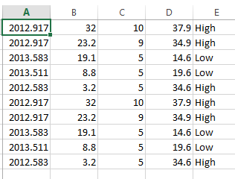
Output:-

Slide 47
Suppose there is a dataset and we have to predict for new student’s result?
Q1 | Q2 | Result
4 | 3 | Fail
6 | 7 | Pass
7 | 8 | Pass
5 | 5 | Fail
8 | 8 | Pass
S6 | Q1:6 | Q2:8
S1
S2
S3
S4
S5
Predict Result ?
S7 | Q1:4 | Q2:5

Slide 48
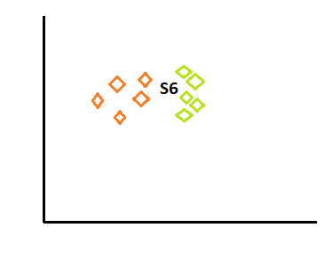

Slide 49
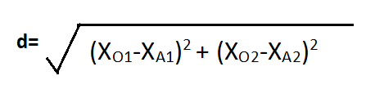
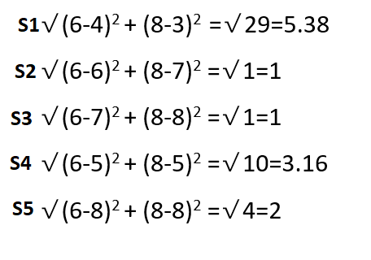
Find Euclidean distance
If k=3 then 3 nearest distance is 1,1, 2 i.e.: S2,S3 and S5

Slide 50
In the above table S2,S3 and S5 Result is Pass, Pass, Pass
So here total Pass is 3
And Fail is 0 so, 3>0
Prediction will be pass

Slide 52
decision trees
Decision Tree is a Supervised learning technique that can be used for both classification and Regression problems, but mostly it is preferred for solving Classification problems. It is a tree-structured classifier, where internal nodes represent the features of a dataset, branches represent the decision rules and each leaf node represents the outcome.
Taking decision and making tree

Slide 53
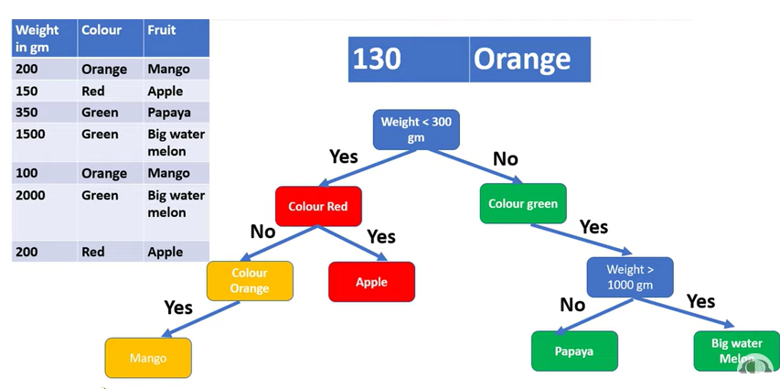
Example

Slide 54
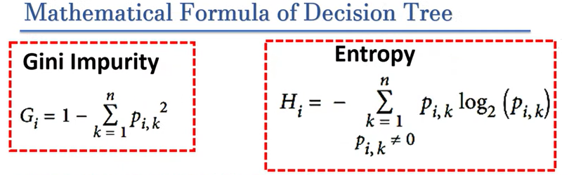
To create root node

Slide 55
Example(https://www.w3schools.com/python/python_ml_decision_tree.asp
In the example, a person will try to decide if he/she should go to a comedy show or not.
Luckily our example person has registered every time there was a comedy show in town, and registered some information about the comedian, and also registered if he/she went or not.

Slide 56
Age | Experience | Rank | Nationality | Go
36 | 10 | 9 | UK | NO
42 | 12 | 4 | USA | NO
23 | 4 | 6 | N | NO
52 | 4 | 4 | USA | NO
43 | 21 | 8 | USA | YES
44 | 14 | 5 | UK | NO
66 | 3 | 7 | N | YES
35 | 14 | 9 | UK | YES
52 | 13 | 7 | N | YES
35 | 5 | 9 | N | YES
24 | 3 | 5 | USA | NO
18 | 3 | 7 | UK | YES
45 | 9 | 9 | UK | YES

Slide 57
Program of Decision Tree
import sys
import matplotlib
matplotlib.use('Agg')
#import sklearn.tree.DecisionTreeClassifier as dt
import pandas
from sklearn import tree
from sklearn.tree import DecisionTreeClassifier
import matplotlib.pyplot as plt
from sklearn.model_selection import train_test_split
from sklearn.metrics import accuracy_score

Slide 58
Program continues
df = pandas.read_csv("C:\\Users\\SUMIT\\OneDrive\\Desktop\\data.csv")
d = {'UK': 0, 'USA': 1, 'N': 2}
df['Nationality'] = df['Nationality'].map(d)
d = {'YES': 1, 'NO': 0}
df['Go'] = df['Go'].map(d)
features = ['Age', 'Experience', 'Rank', 'Nationality']
X = df[features]
y = df['Go']
X_train, X_test, y_train, y_test = train_test_split(X,y, test_size=0.3,random_state=0)

Slide 59
Program continues..
dtree = DecisionTreeClassifier()
dtree = dtree.fit(X_train, y_train)
y_pred_test = dtree.predict(X_test)
y_pred_train = dtree.predict(X_train)
accuracy = accuracy_score(y_pred_train,y_train)
print("Train Accuracy:", accuracy)
accuracy1 = accuracy_score(y_pred_test,y_test)
print("Test Accuracy:", accuracy1)

Slide 60

Output:-

Slide 61
Now, based on this data set, Python can create a decision tree that can be used to decide if any new shows are worth attending to.
To make a decision tree, all data has to be numerical.
We have to convert the non numerical columns 'Nationality' and 'Go' into numerical values.
Pandas has a map() method that takes a dictionary with information on how to convert the values.
{'UK': 0, 'USA': 1, 'N': 2}

Slide 62
Means convert the values 'UK' to 0, 'USA' to 1, and 'N' to 2.

Slide 63
Means convert the values 'UK' to 0, 'USA' to 1, and 'N' to 2.
Then we have to separate the feature columns from the target column.
The feature columns are the columns that we try to predict from, and the target column is the column with the values we try to predict.

Slide 64
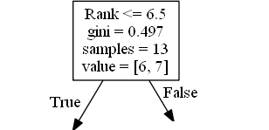

Slide 65
Rank <= 6.5 means that every comedian with a rank of 6.5 or lower will follow the True arrow (to the left), and the rest will follow the False arrow (to the right).
gini = 0.497 refers to the quality of the split, and is always a number between 0.0 and 0.5, where 0.0 would mean all of the samples got the same result, and 0.5 would mean that the split is done exactly in the middle.
samples = 13 means that there are 13 comedians left at this point in the decision, which is all of them since this is the first step.

Slide 66
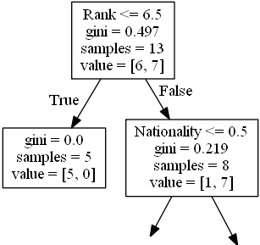

Slide 67
The next step contains two boxes, one box for the comedians with a 'Rank' of 6.5 or lower, and one box with the rest.
True - 5 Comedians End Here:
gini = 0.0 means all of the samples got the same result.
samples = 5 means that there are 5 comedians left in this branch (5 comedian with a Rank of 6.5 or lower).
value = [5, 0] means that 5 will get a "NO" and 0 will get a "GO".

Slide 68
False - 8 Comedians Continue:
Nationality <= 0.5 means that the comedians with a nationality value of less than 0.5 will follow the arrow to the left (which means everyone from the UK, ), and the rest will follow the arrow to the right.
gini = 0.219 means that about 22% of the samples would go in one direction.
samples = 8 means that there are 8 comedians left in this branch (8 comedian with a Rank higher than 6.5).
value = [1, 7] means that of these 8 comedians, 1 will get a "NO" and 7 will get a "GO".

Slide 69
Random forests
Random forests is the supervised learning technique. It is based on the concept of ensemble learning, which is a process of combining multiple classifiers to solve a complex problem and to improve the performance of the model.
"Random Forest is a classifier that contains a number of decision trees on various subsets of the given dataset and takes the average to improve the predictive accuracy of that dataset."

Slide 70
Let’s suppose you have decided to ask your friends, and talked with them about their past travel experience to various places. You will get some recommendations from every friend. Now you have to make a list of those recommended places. Then, you ask them to vote (or select one best place for the trip) from the list of recommended places you made. The place with the highest number of votes will be your final choice for the trip.

Slide 71
In the above decision process, there are two parts. First, asking your friends about their individual travel experience and getting one recommendation out of multiple places they have visited. This part is like using the decision tree algorithm. Here, each friend makes a selection of the places he or she has visited so far.

Slide 72
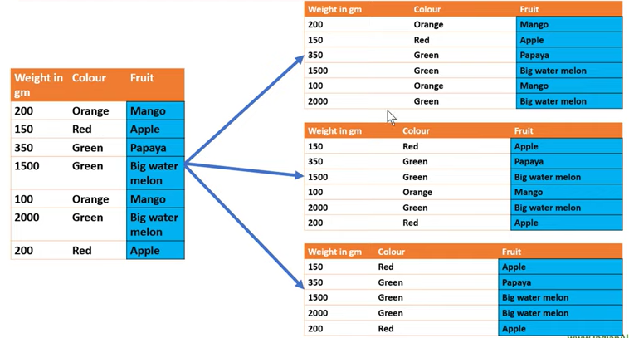

Slide 73
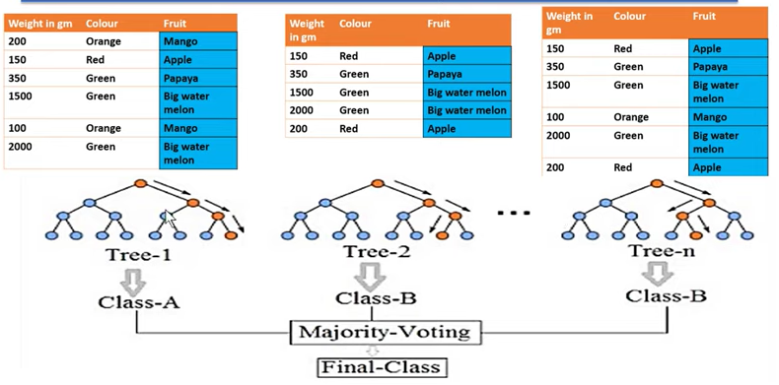

Slide 74
#Fitting Decision Tree classifier to the training set
from sklearn.ensemble import RandomForestClassifier
classifier= RandomForestClassifier(n_estimators= 10, criterion="entropy")
classifier.fit(x_train, y_train)
n_estimators= The required number of trees in the Random Forest.
#Predicting the test set result
y_pred= classifier.predict(x_test)

Slide 75
Random Forest Example
from matplotlib import pyplot as plt
import pandas as pd
from sklearn.ensemble import RandomForestClassifier
from sklearn.model_selection import train_test_split
df = pd.read_csv('C:\\Users\\SUMIT\\OneDrive\\Desktop\\hdata.csv')
x = df.iloc[:,[2,3]].values

Slide 76
Example continues…
y = df.iloc[:,4].values
x_train, x_test, y_train, y_test = train_test_split(
x, y, test_size=0.6, random_state=0)
classifier= RandomForestClassifier().fit(x_train, y_train)
y_pred= classifier.predict(x_train)
print(y_pred)

Slide 77

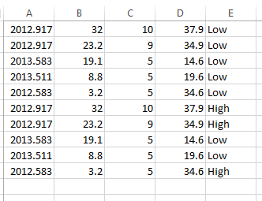
Output:-

Slide 78
k-means clustering
K-Means Clustering is an unsupervised learning algorithm that is used to solve the clustering problems in machine learning or data science.
K-Means Clustering is an Unsupervised Learning algorithm, which groups the unlabeled dataset into different clusters. Here K defines the number of pre-defined clusters that need to be created in the process, as if K=2, there will be two clusters, and for K=3, there will be three clusters, and so on.

Slide 79
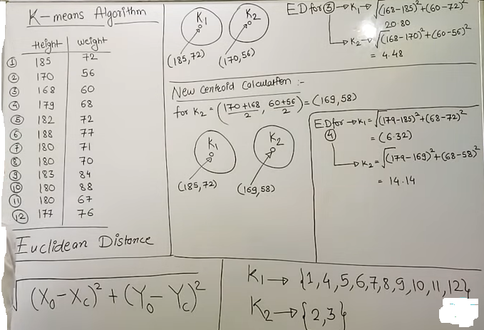

Slide 80
Pick any two rows make two centroid
Now take 3rd row and find Euclidean distance for k1 and k2
If distance is less value then take tat row in that cluster and find new centroid
k1
k2
K=2 | height | wt
1 | 185 | 72
2 | 170 | 56
3 | 168 | 60
4
5
6
7
8
9
10
11
12
(185,72)
(170,56)

Slide 81
from sklearn.cluster import Kmeans
kmeans = KMeans(n_clusters=2) kmeans.fit(data)

Slide 82
K-means clustering example
import matplotlib.pyplot as plt
from sklearn.cluster import KMeans
x = [4, 5, 10, 4, 3, 11, 14 , 6, 10, 12]
y = [21, 19, 24, 17, 16, 25, 24, 22, 21, 21]
data = list(zip(x, y)) #[(4,21),(5,19)]
inertias = []

Slide 83
Program continues…
for i in range(1,11):
kmeans = KMeans(n_clusters=i)
kmeans.fit(data)
inertias.append(kmeans.inertia_)
plt.plot(range(1,11), inertias, marker='o')
plt.title('Elbow method')
plt.xlabel('Number of clusters')
plt.ylabel('Inertia')
Plt.show()

Slide 84
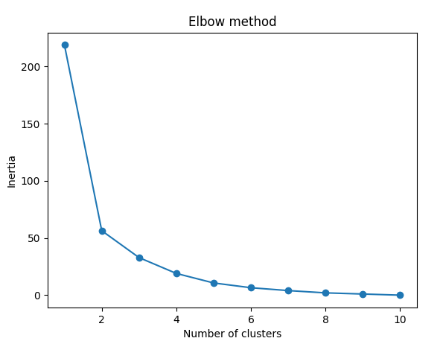
Output:--

Slide 85
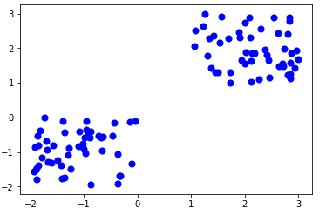

Slide 86
Thanks!!!

